Slide 1
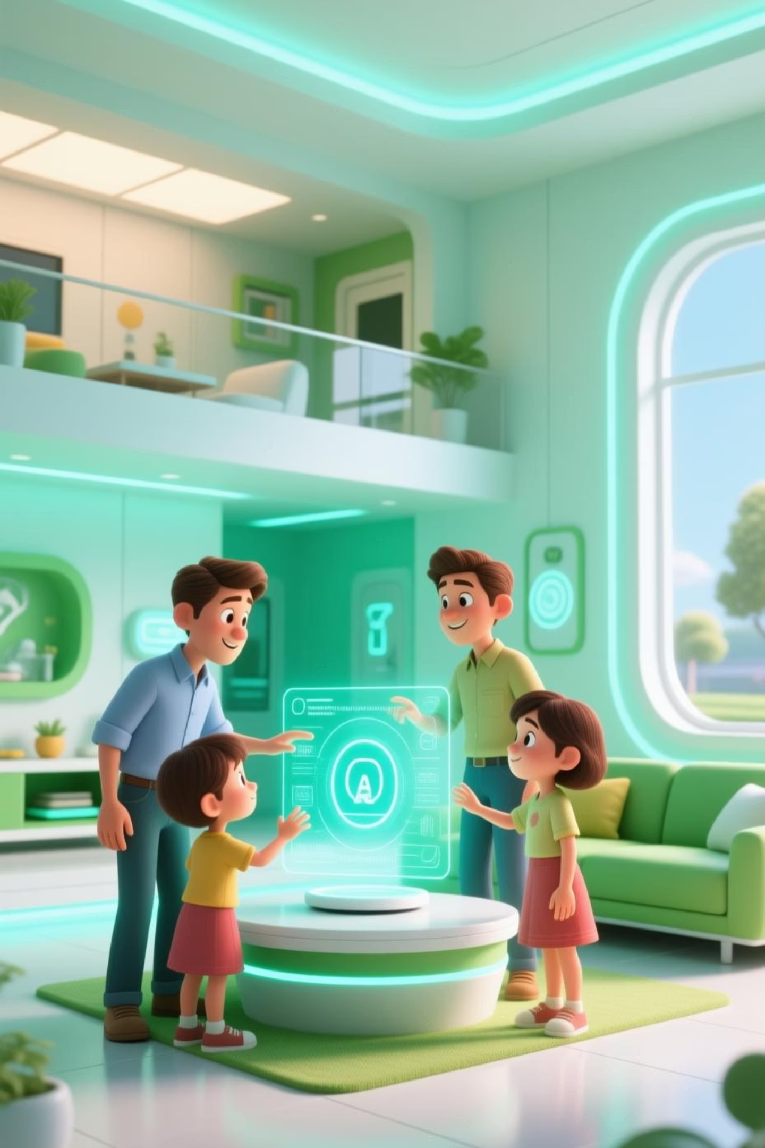
Voice-Activated AI Chatbots: The Future of Human-Machine Interaction
Explore how voice-activated AI is transforming digital interactions and setting new standards for convenience and efficiency.

Slide 2



Why Voice? The Rise of Voice-Activated AI
Explosive Growth
User Preference
A Necessity, Not a Novelty
Over 4.2 billion digital voice assistants active globally in 2023, projected to double by 2024.
71% of users prefer voice assistants over typing for quick searches and tasks.
Voice-first interaction is rapidly becoming essential for seamless user experiences.
The demand for intuitive, hands-free interaction is reshaping how we engage with technology, making voice AI a critical component of modern digital strategies.

Slide 3
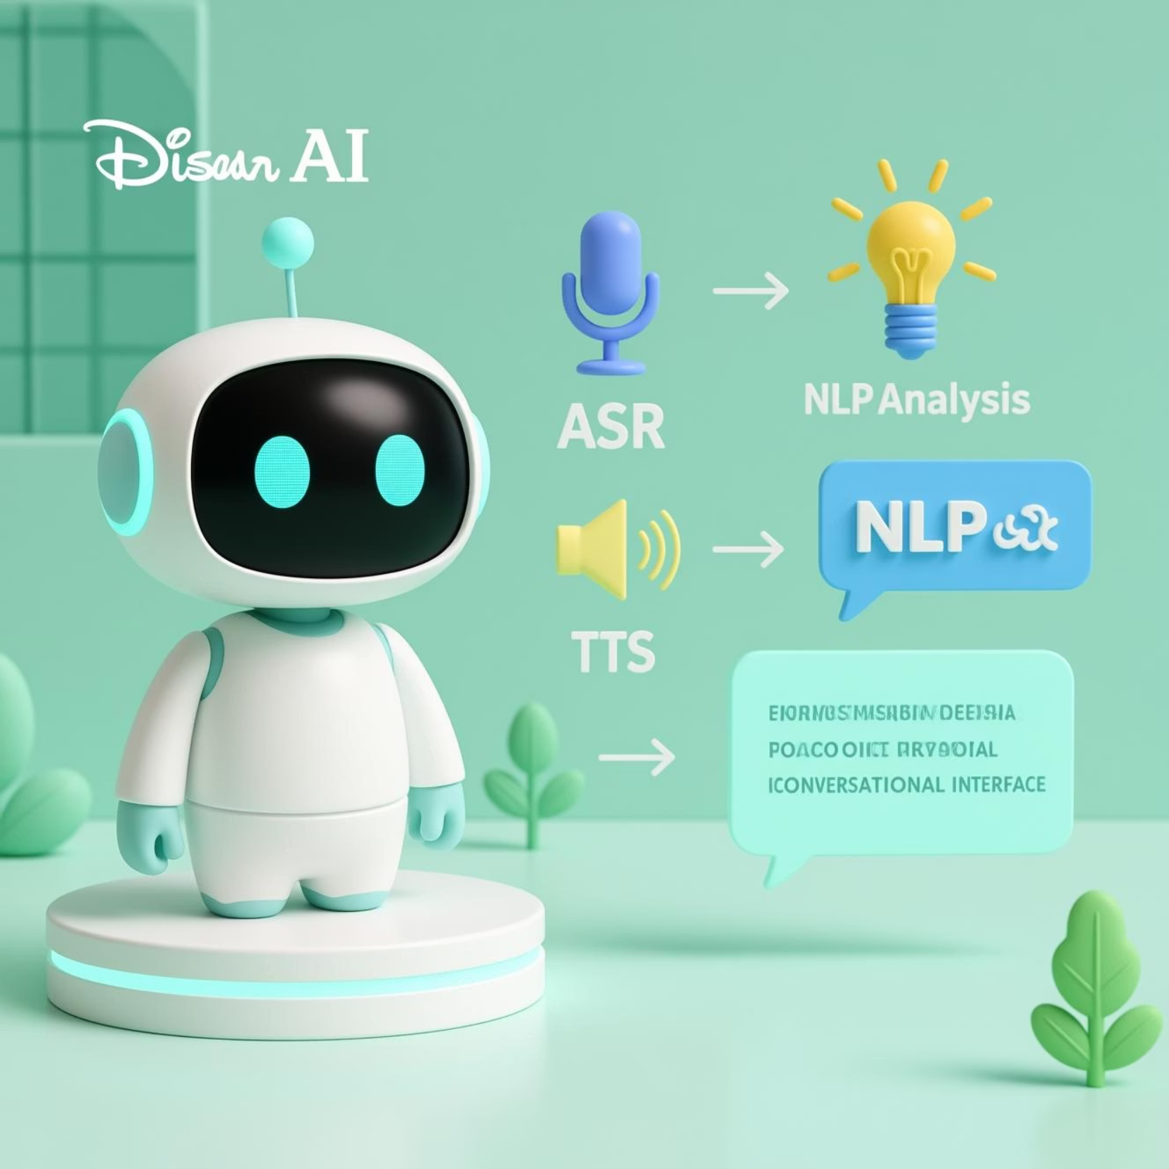
What Is a Voice-Activated AI Chatbot?
A voice-activated AI chatbot is an advanced conversational agent that combines cutting-edge technologies to enable natural, spoken interactions.
Understands spoken language through Automatic Speech Recognition (ASR).
Interprets user intent and context using Natural Language Processing (NLP).
Responds naturally and in real-time with Text-to-Speech (TTS) capabilities.
This allows for hands-free, dynamic user experiences that go far beyond traditional text-based chatbots.

Slide 4
How Voice Chatbots Work: Core Technologies
01
02
Speech to Text (ASR)
Intent & Meaning (NLP)
speech-to-text implementation with a modern, user-friendly interface. This solution will use the Web Speech API for speech recognition.
NLP engines such as Dialogflow or Microsoft LUIS extract the user's intent, entities, and context from the transcribed text.
03
04
Natural Voice Response (TTS)
Backend Integration
TTS technology synthesizes highly natural and human-like voice responses for a seamless conversational flow.
Web Interface: Modern, responsive UI accessible through any web browser
Multi-threaded Operations: Handles speech synthesis without blocking the main application
These components work in concert to create an intelligent and responsive conversational experience.

Slide 5
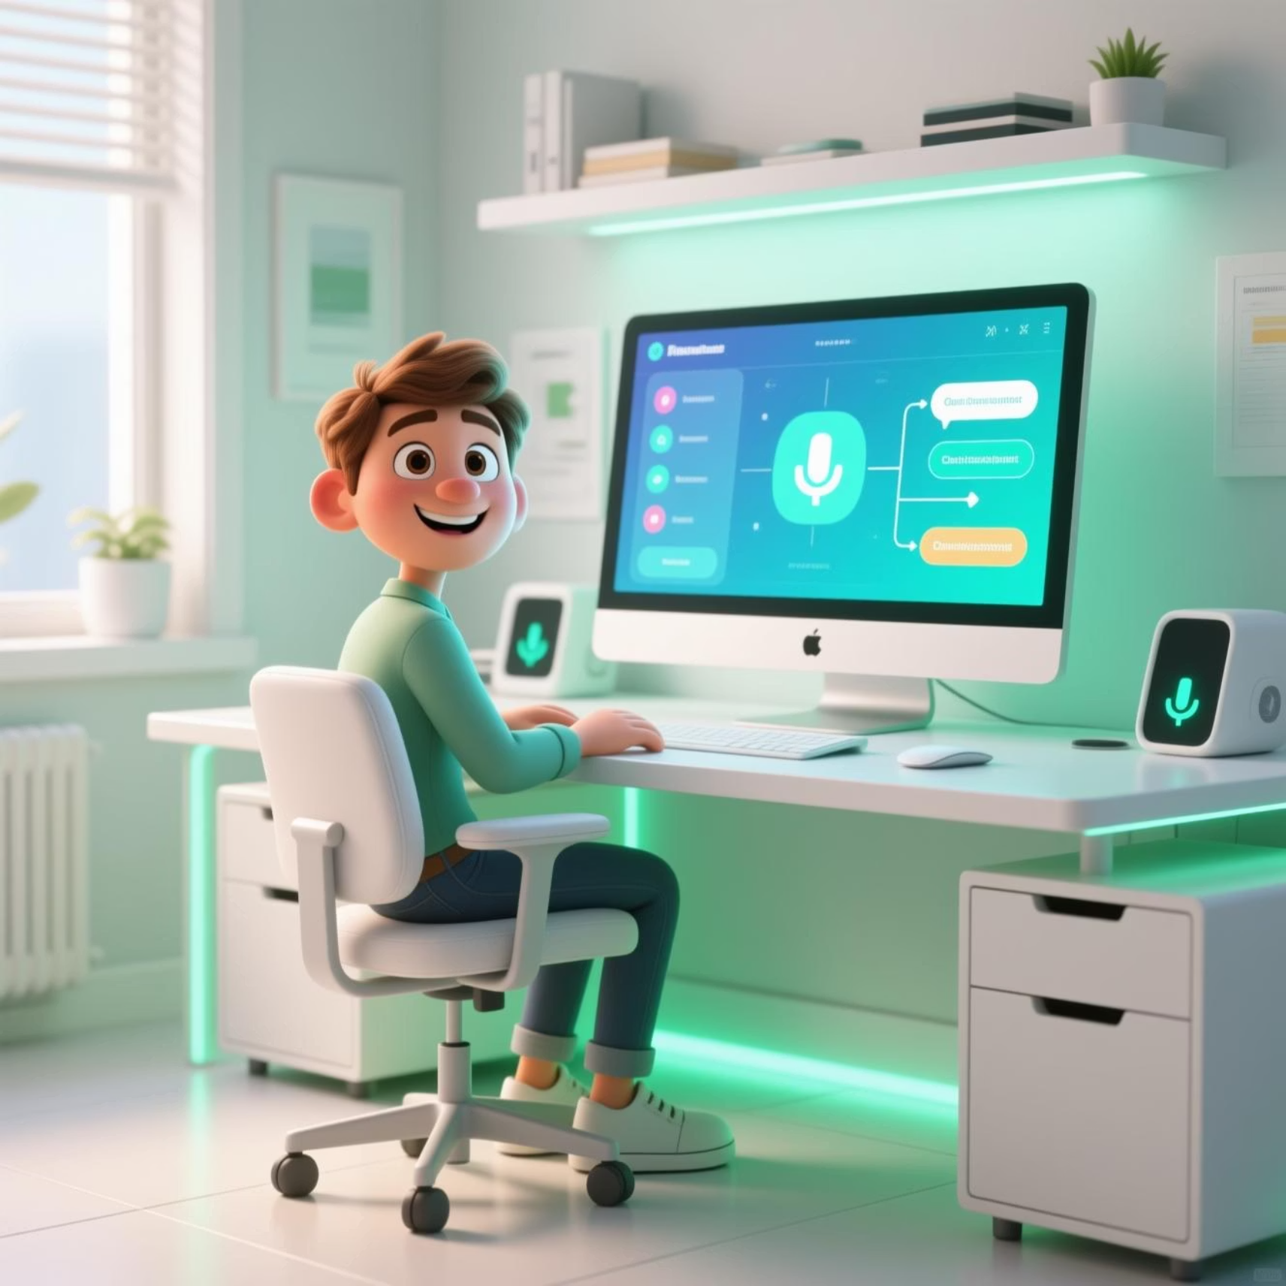
Building a Voice Chatbot: Step-by-Step
Define Purpose & Use Cases
Clearly outline the chatbot's role, whether it's for customer support, appointment booking, or information retrieval.
Choose Your Platform
Select suitable platforms like Amazon Alexa, Google Assistant, or Microsoft Azure Bot Framework.
Design Conversation Flows
Utilize tools such as Voiceflow or Botmock to design intuitive and natural dialogue paths.
Develop & Integrate
Build the backend, integrate necessary APIs, and implement core voice recognition and NLP components.
Test & Refine
Conduct extensive testing to ensure robust error handling and a polished user experience.

Slide 6


Real-World Impact: Business Benefits & Use Cases
Voice-activated AI chatbots are revolutionizing operations across industries, delivering tangible benefits and improving efficiency
Commands:
Commands
Command Support
Greetings: "Hello", "Hi", "Hey"
Time/Date: "What time is it?", "What's the date?"
Web Search: "Search for artificial intelligence"
Wikipedia: "Wikipedia Python programming"
Open Websites: "Open YouTube", "Open Google", "Open Stack Overflow"
Jokes: "Tell me a joke"
Weather: "How's the weather?" (placeholder implementation)
Exit: "Goodbye", "Exit", "Quit"
These applications lead to 70% automation of Level 1 support tickets, significantly reducing operational costs and boosting customer satisfaction.

Slide 7

Market Momentum & Investment
Technology Stack
Backend: Flask (Python web framework)
Speech Recognition: Speech Recognition library with Google Speech API
Text-to-Speech: pyttsx3 for offline speech synthesis
Web Integration: Wikipedia API, Web browser module
Frontend: HTML5, CSS3, JavaScript
Additional Python Libraries: Requests, Threading, Datetime
The Voice Assistant Market is poised for massive expansion, driven by continuous innovation.
This significant growth underscores the increasing confidence and investment in voice AI technologies.

Slide 8
Cutting-Edge Innovations & Trends
1
2
Generative AI
Retrieval Augmented Generation (RAG)
Models like GPT-4o enhance conversational depth, context, and personalization, leading to more natural interactions.
Enables bots to access and synthesize information from live knowledge bases dynamically, ensuring up-to-date responses.
3
4
Multilingual Support
Real-Time Voice-to-Voice
Bots are increasingly offering support in multiple languages, improving global user experiences and market reach.
Seamless, human-like conversations without any typing, further blurring the lines between human and AI interaction.
These advancements are making voice AI chatbots more intelligent, versatile, and indispensable.

Slide 9
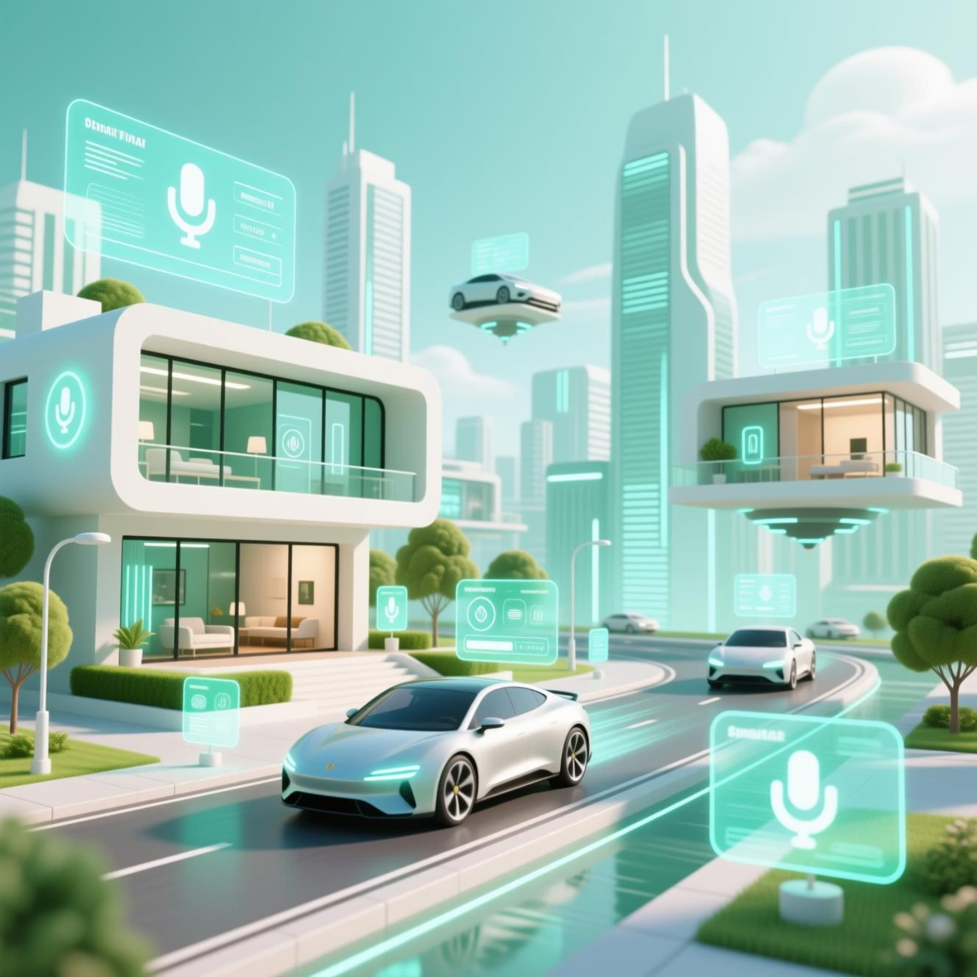
Challenges & Future Outlook
Current Challenges
Privacy & Data Security: Ensuring sensitive voice data is protected and used ethically.
Handling Diversity: Accurately interpreting diverse accents, noisy environments, and complex queries.
Continuous Improvement: The need for constant learning and refinement to maintain accuracy and user satisfaction.
Future Outlook
Voice AI will become ubiquitous, embedded in smart homes, autonomous vehicles, wearables, and enterprise workflows, making interaction truly seamless and intuitive. The revolution is just beginning.

Slide 10
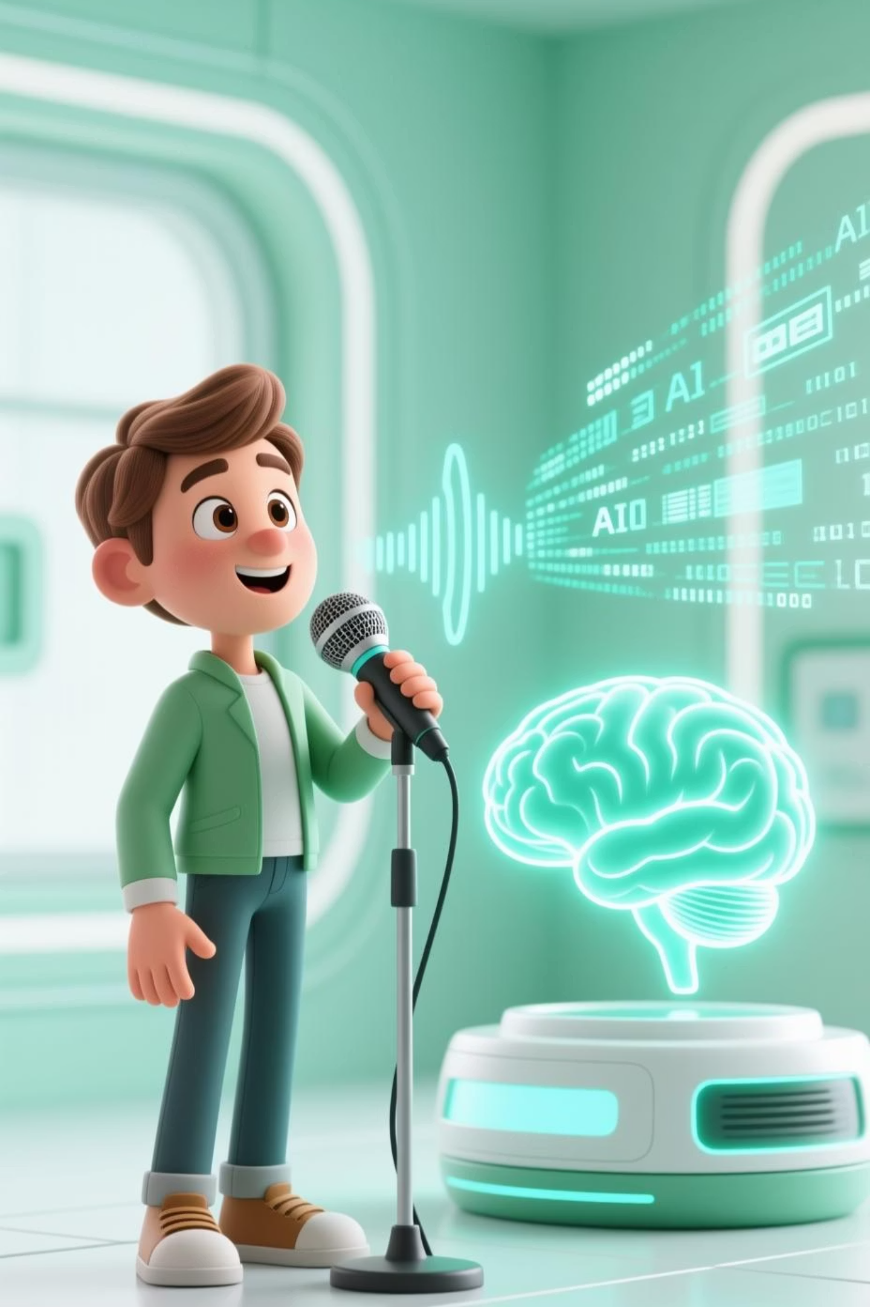


The Voice-Activated AI Chatbot Revolution Is Here
Voice AI is transforming how businesses engage customers—faster, smarter, and more naturally.
Now is the opportune moment to harness this powerful technology to elevate your digital strategy and enhance user experience. The tools, market opportunity, and user demand for voice have never been stronger.

